Slide 1
Machine Learning
Chloe He 46807050
Southern Methodist University

Slide 2
Basic Machine Learning Parts
Model
Parameters
Objective Function = Training loss + Regularization

Slide 3
Table of Contents No dimension reduction
Bagging
Boosting
XGBoost
Random Forest
Deep Neural Network
Support Vector Machine
Results Comparison
Conclusion
In each sub section, I will include:
Basic Information
Algorithm Demonstration
Statistical Significance
Tuning Parameters
Application on Decomposition Dataset

Slide 4
Bagging
Application: Regression and Classification
Statistical Definition: Bagging stands for Bootstrap AGGregatING, meaning that we will randomly select subsample from training set with replacement to learn from the dataset, and will determine the final predicted value by method of voting (if classification), by averaging (if regression)
N Randomly selected subsets
Model 1
Population
Voting
Decision
Model 2
Model 3
Model N

Slide 5
Bagging
Motivation:
Outliers will affect the model parameter, which leads to overfitting and high variance
Model Accuracy is an issue
Assumptions/Prerequisites:
Instability of training set (only then will bagging improve accuracy)
Advantages:
By averaging predictor parameters, bagging will effectively down-weight the influences from outliers (Bad Leverages) (Yves 2004)
Improve Accuracy (Breiman 1994)
Disadvantages:
Down-weight good leverages at the same time (Yves 2004)
Complicated interpretation (Breiman 1994)

Slide 6
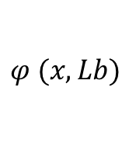
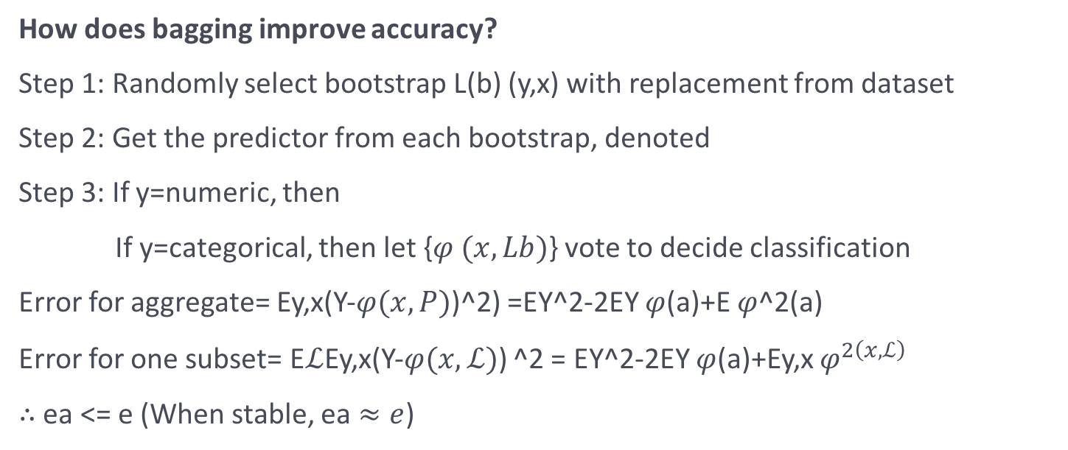
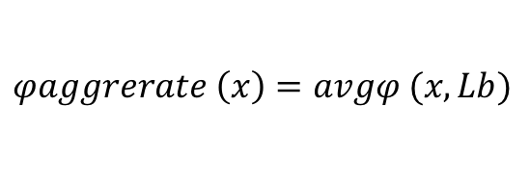
Bagging
How does bagging improve accuracy?
Step 1: Randomly select bootstrap L(b) (y,x) with replacement from dataset
Step 2: Get the predictor from each bootstrap, denoted
Step 3: If y=numeric, then
If y=categorical, then let {$φ (x,Lb)$} vote to decide classification
Error for aggregate= Ey,x(Y-$φ(x,P)$)^2) =EY^2-2EY $φ$(a)+E $φ$^2(a)
Error for one subset= E$ℒ$Ey,x(Y-$φ(x,ℒ)$) ^2 = EY^2-2EY $φ$(a)+Ey,x $φ^{2\left(x,ℒ\right)}$
$∴$ ea <= e (When stable, ea $≈e$)
$$φ (x,Lb)$$
$$φaggrerate \left(x\right)=avgφ (x,Lb)$$

Slide 7
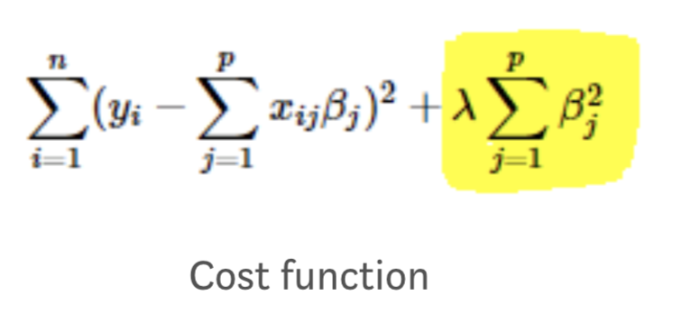
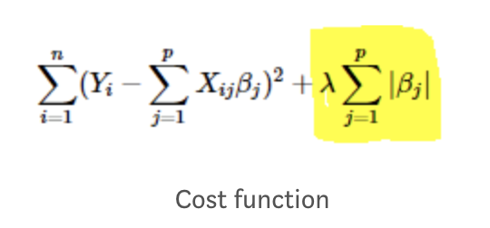
Bagging
Tuning Parameters:
Alpha (Avoid overfitting by suppressing irrelevant variables):
Alpha = 0 Ridge Regression L2 Regularization (“squared magnitude” of coefficient)
Alpha = 1 LASSO Regression L1 Regularization (sums of absolute values of a vector’s all components)
0 < Alpha < 1 Elastic Net Regression
Lambda (Penalty Term)

Slide 8
Bagging Application
Basic Set Up: 10 iterations, 11 models, 24 test observations, 54 train observations (18 tissue, 36 random nontissue sampled with replacement)
Note: The reason that we chose 11 models was that according to Leo Breiman (Breiman 1996), after 11 models ensemble, the accuracy won’t improve substantially.

Slide 9
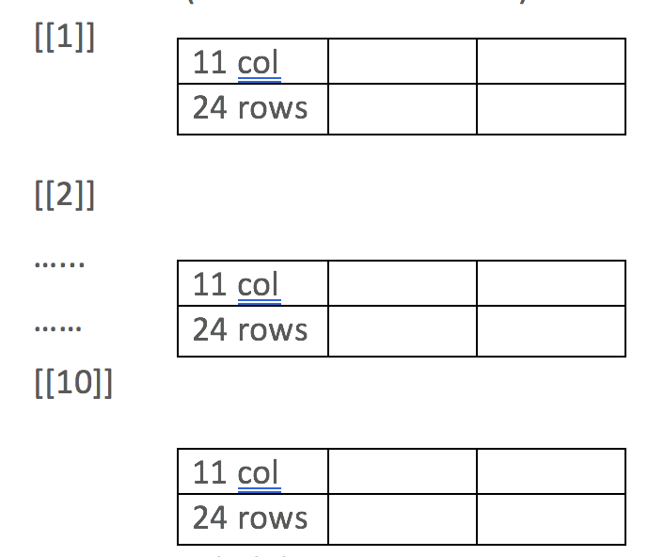
Bagging Application
Matrices and Indexes:
Lambda and Alpha matrices (11 rows*10 columns) to keep track of which tuning parameters we used for each model and every iteration.
Probability matrix to record the decision for test samples under 11 models for each of the 10 iterations. (Demonstration on right)

Slide 10
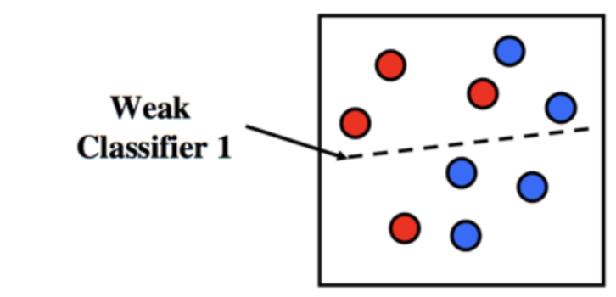
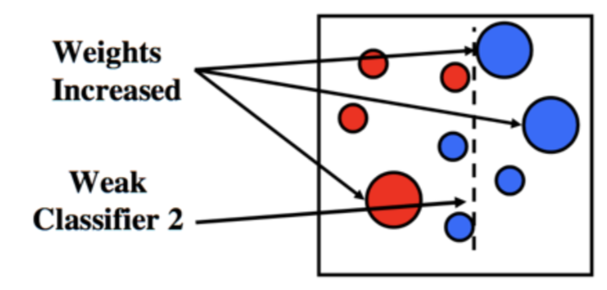
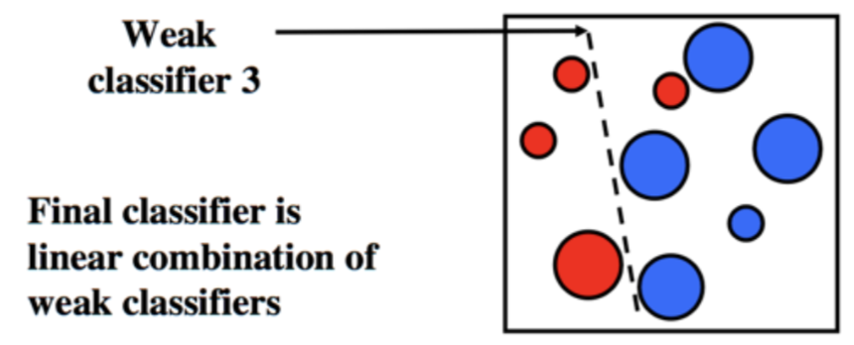
Boosting
Application: Classification
Statistical Definition: Boosting has to deal with giving extra attention to the observations that got misclassified in the previously round, and build more robust models trying to fix those misclassifications.

Slide 11
Boosting
Motivation:
Can a set of weak learners create a single strong learner ?
Advantage:
Decreasing training error
No-tuning
Requires no knowledge for previous learner (Freund 1999)
Disadvantage:
Susceptible to noises

Slide 12
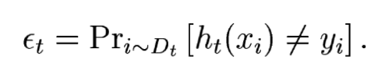
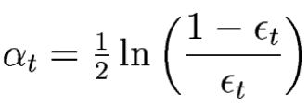
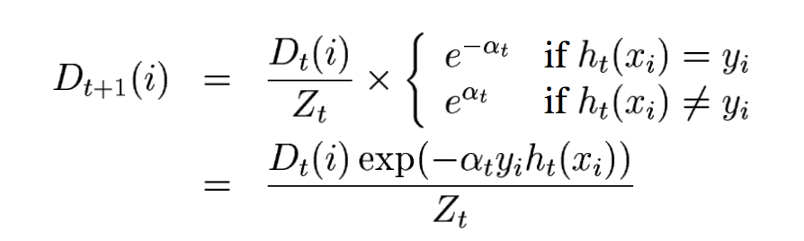
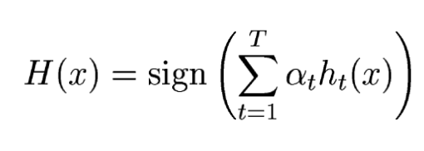
Boosting
Updating Weights Mechanism
Step 1: Initialize weight D1(i) = 1/m (m=# of observations in training)
Step 2: For t=1….T (Each iteration), get weak learner with error
Step 3: Choose
Step 4: Update weights
Step 5: Final strong learner:
Alpha measures the importance of a learner
Z is normalization term
Weighted Majority Vote

Slide 13
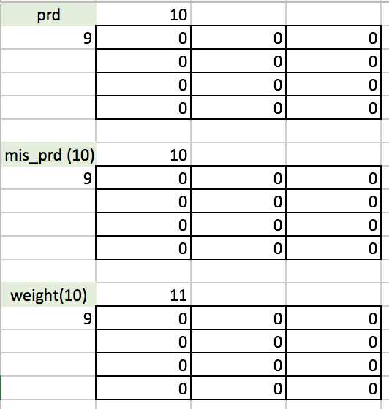
Boosting Application
Iterations
10 models, 10 iterations; 24 test observations; 57 training (selected with replacement): 48 for learning, 9 for validation (Need validation set to change weights accordingly).
Matrices Set Up
“Prd” “Mis_prd” and “Weights” (9 rows*10 columns) for keeping track of results from validation set (9 samples) under 10 models; “Probability” matrix (24 rows* 10 columns) to record classification results for 24 test samples

Slide 14
XGBoost
Developed by Chen Tianqi
Motivation
Rather than constructing parallel decision trees like random forest, how can we add new trees to existing ones to fix mistakes.
Advantage
Lower error
Take penalty term into consideration
Disadvantage
Training time

Slide 15
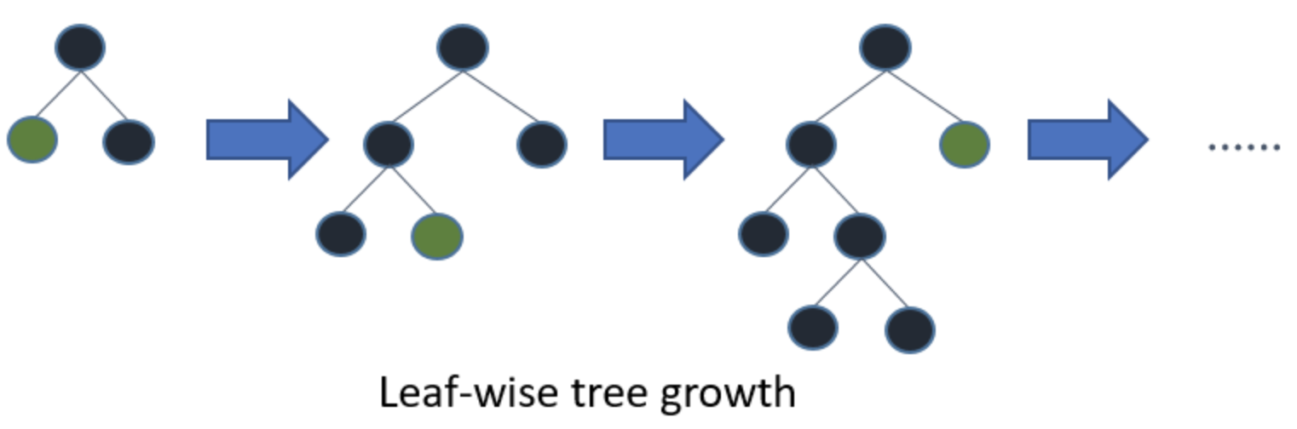
XGBoost
Application: Regression and Classification
Statistical Definition: XGBoost identifies difficult observations by large residuals computed previously and adds new learners to the existing weak learners to correct those misclassifications iteratively. Working backward at the end to prune unnecessary trees based on loss reduction function. (Grow trees one by one)

Slide 16
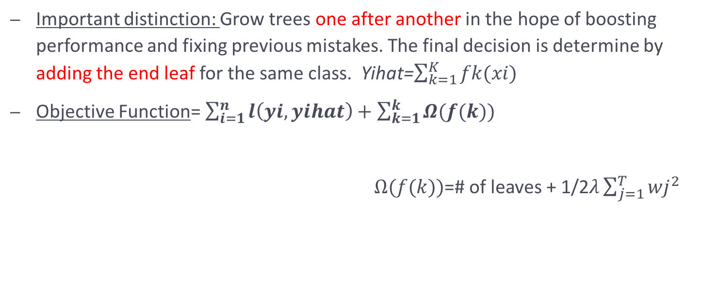
XGBoost
Important distinction: Grow trees one after another in the hope of boosting performance and fixing previous mistakes. The final decision is determine by adding the end leaf for the same class. Yihat=$\sum_{k=1}^{K}{fk(xi)}$
Objective Function= $\sum_{i=1}^{n}{l\left(yi,yihat\right)}+\sum_{k=1}^{k}{Ω(f(k))}$
$Ω(f(k))$=# of leaves + 1/2$λ\sum_{j=1}^{T}{{wj}^{2}}$
Residual Function
Complexity of the tree
L2 Norm of leaf score

Slide 17
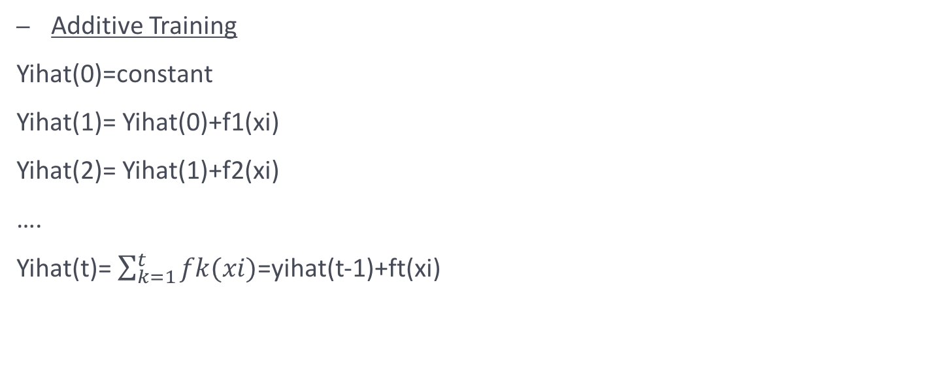
XGBoost
Additive Training
Yihat(0)=constant
Yihat(1)= Yihat(0)+f1(xi)
Yihat(2)= Yihat(1)+f2(xi)
….
Yihat(t)= $\sum_{k=1}^{t}{fk(xi)}$=yihat(t-1)+ft(xi)
Start simple
The new additive function

Slide 18
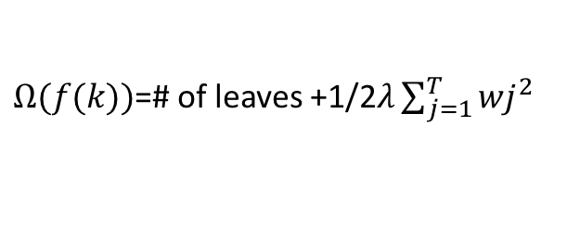
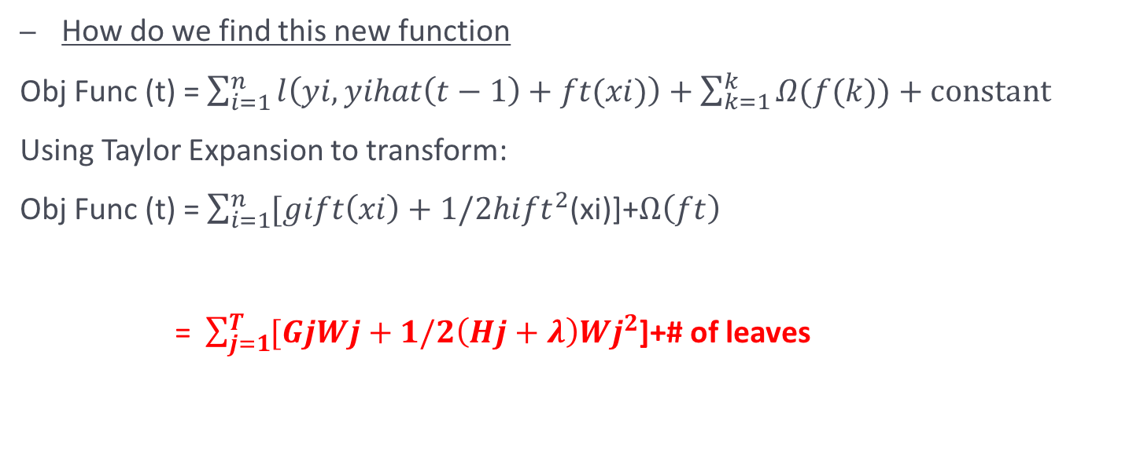
XGBoost
How do we find this new function
Obj Func (t) = $\sum_{i=1}^{n}{l\left(yi,yihat\left(t−1\right)+ft(xi)\right)}+\sum_{k=1}^{k}{Ω(f(k))}+constant$
Using Taylor Expansion to transform:
Obj Func (t) = $\sum_{i=1}^{n}{[gift\left(xi\right)+1/2hi{ft}^{2}}$(xi)]+$Ω\left(ft\right)$
= $\sum_{j=1}^{T}{[GjWj+1/2\left(Hj+λ\right){Wj}^{2}}$]+# of leaves
First Derivative
Second Derivative
Complexity of tree
$Ω(f(k))$=# of leaves +1/2$λ\sum_{j=1}^{T}{{wj}^{2}}$

Slide 19
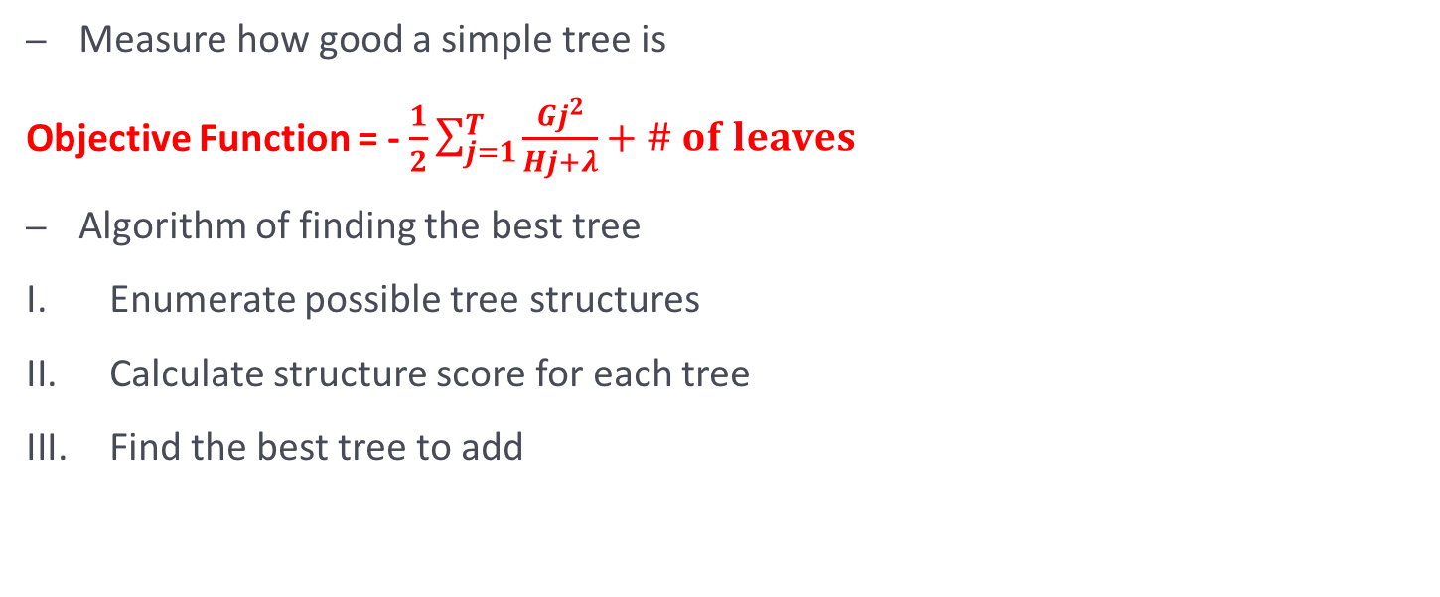
XGBoost
Measure how good a simple tree is
Objective Function = - $\frac{1}{2}\sum_{j=1}^{T}{\frac{{Gj}^{2}}{Hj+λ}}+\# of leaves$
Algorithm of finding the best tree
Enumerate possible tree structures
Calculate structure score for each tree
Find the best tree to add

Slide 20
XGBoost
Tuning Parameters:
Lambda: as explained before
Alpha: as explained before
Gamma: determines the minimum loss reduction needed to further grow trees, is an important part of tree growing algorithm
Note: Getting the best parameter through cross validation. Cross Validation also gives us the best “iteration” number (How deep to grow the tree).

Slide 21
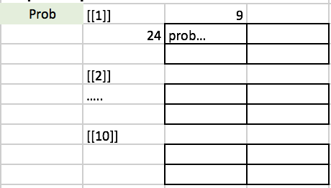
XGBoost
Iterations
9 models, 10 iterations; 24 test observations; 54 training (selected with replacement)
Matrices Set Up
M matrix and Probability matix to keep track of the predicted result for 24 test samples under each of the 9 models for 10 iterations. (Demo on left)

Slide 22
Random Forest
Advantage
Avoid Overfitting
Tuning parameters are easy to understand
Disadvantage
Longer Training time

Slide 23
Random Forest
Application: Regression and Classification
Statistical Definition: This has to do with learning from the dataset from a subset of observations and a subset of variables. It grows pre-determined number of trees and makes final classification decisions based on the voting (Segal 2011). Grow uncorrelated trees
Note: Different from XGBoost, Random Forest algorithm grows parallel trees. More like Bagging

Slide 24
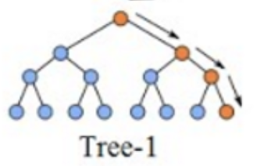
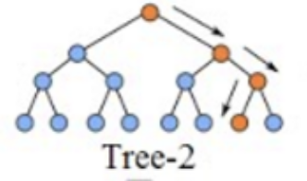
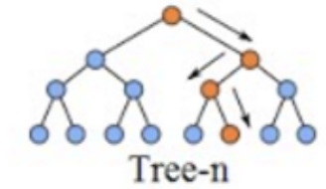
Population
Extract subset of observations (w/replacement) and subset of features (w/o replacement)
………..
Class A
Class B
………..
Class A
By Voting
Class A

Slide 25
Random Forest
Tuning parameters:
Number of features (variables) to tryout
Number of trees to grow

Slide 26
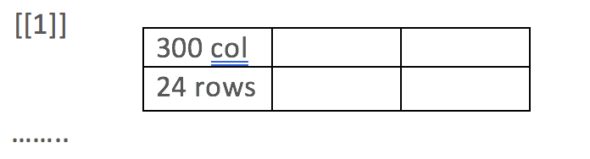
Random Forest
Basic Set Up: 10 iterations, 300 trees, test set 24 * 419, training set 54 * 20 (randomly selected 20 features without replacement)
Matrices Set Up: “Probability” matrix: 10 matrices, each of which 24*300, keeping track of the final classification for 24 test observations under each of the 300 trees for 10 iterations.

Slide 27
Deep Neural Network
Motivation
Artificial Intelligence
Advantages
No assumptions about the data
Disadvantages
Longer training time

Slide 28
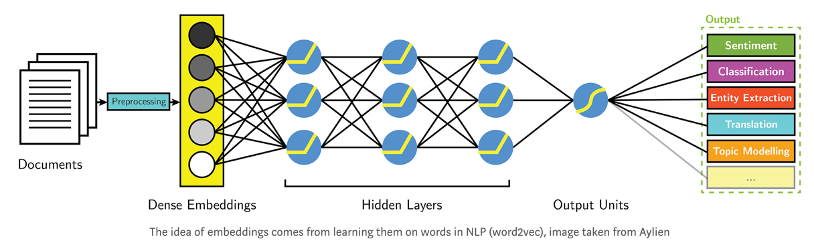
Deep Neural Network
Applications: Classification and Regression
Statistical Definition: Deep Neural Network is an important algorithm in the arena of machining learning given its impressive performance (AlphaGo). It works by activating neurons in multiple hidden layers and finally activating the output layer that predict the final classification by calculating the probability of each output.
Weighted

Slide 29
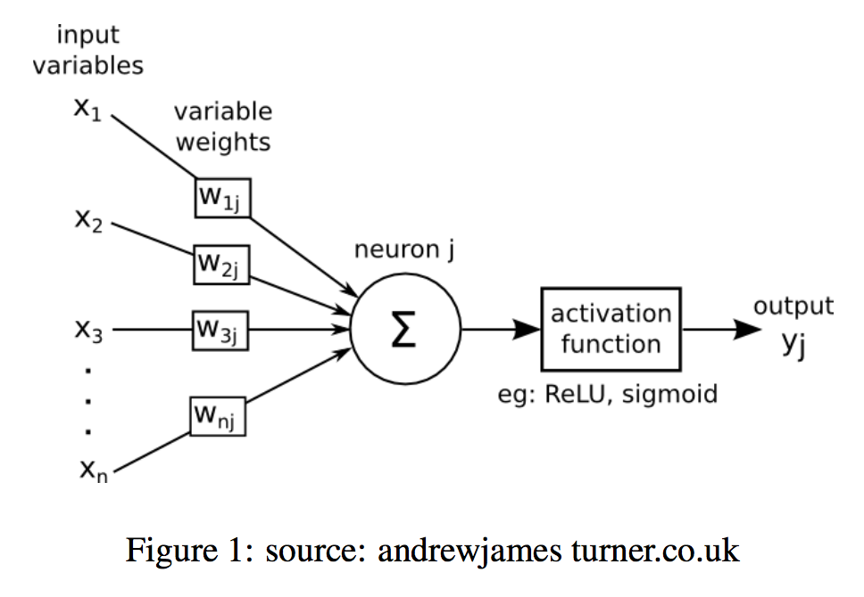
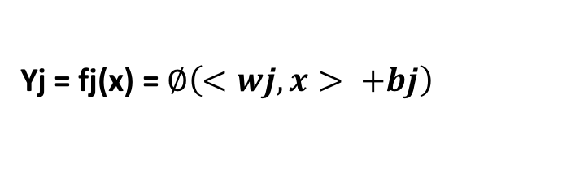
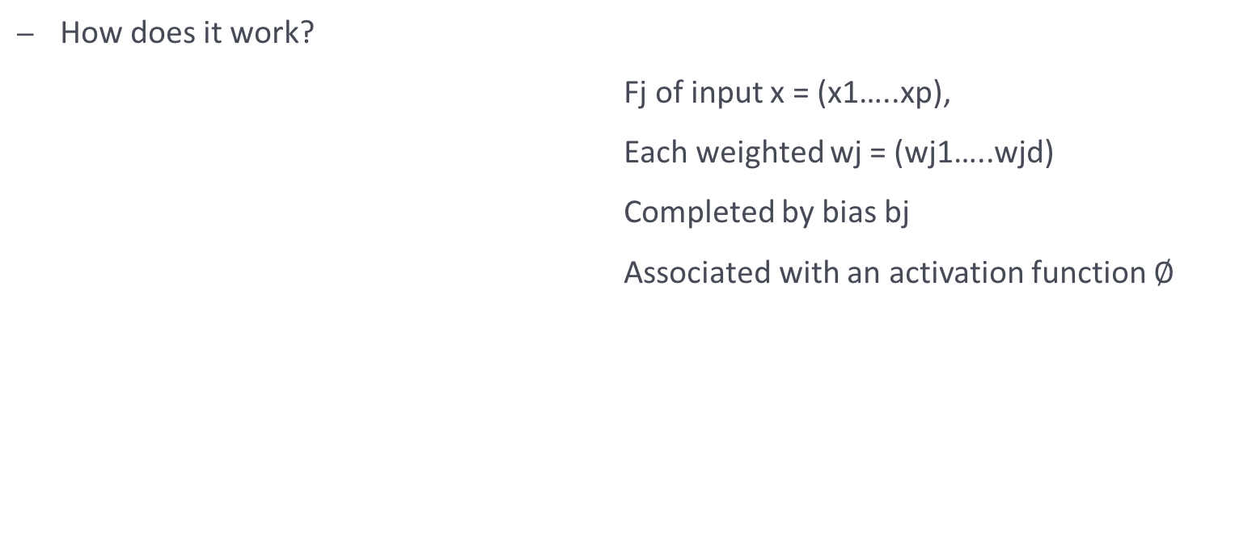
Deep Neural Network
How does it work?
Fj of input x = (x1…..xp),
Each weighted wj = (wj1…..wjd)
Completed by bias bj
Associated with an activation function $∅$
Yj = fj(x) = $∅\left(<wj,x> +bj\right)$

Slide 30
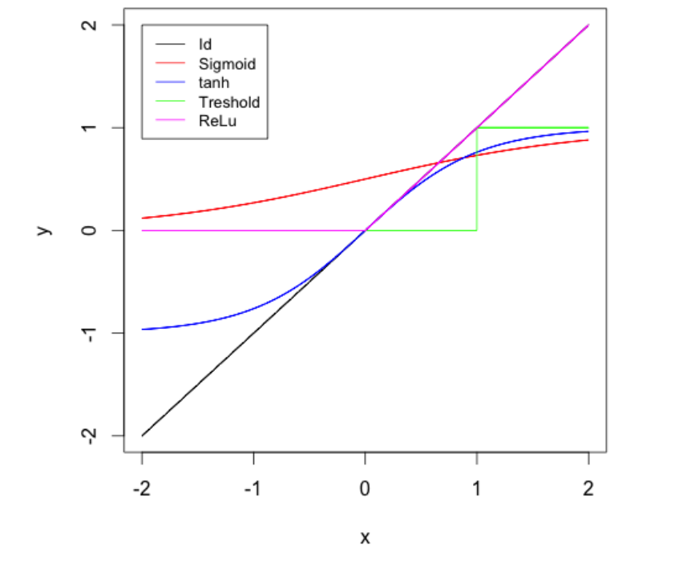
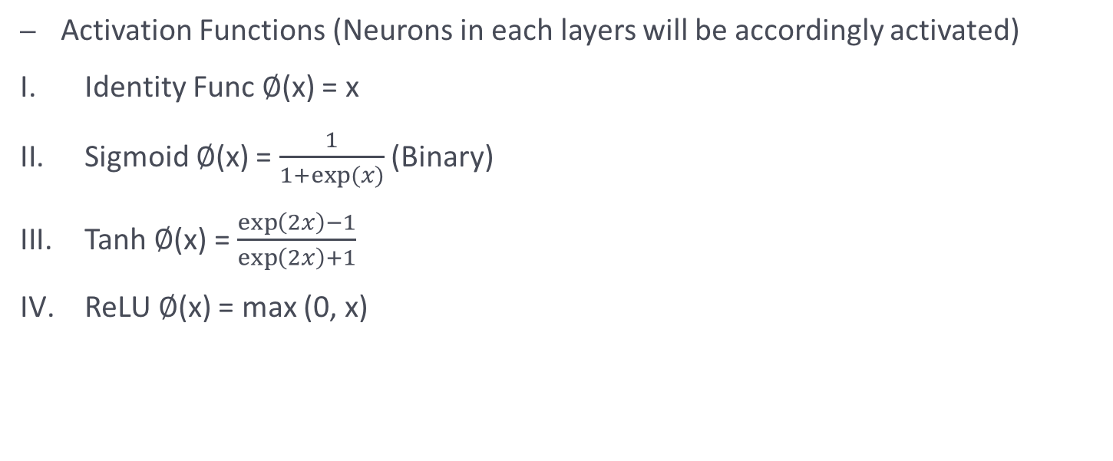
Deep Neural Network
Activation Functions (Neurons in each layers will be accordingly activated)
Identity Func $∅$(x) = x
Sigmoid $∅$(x) = $\frac{1}{1+exp⁡(x)}$ (Binary)
Tanh $∅$(x) = $\frac{\exp\left(2x\right)−1}{\exp\left(2x\right)+1}$
ReLU $∅$(x) = max (0, x)

Slide 31
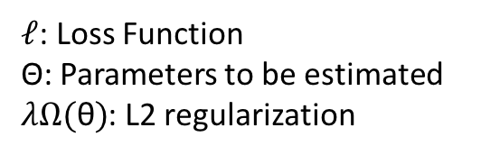
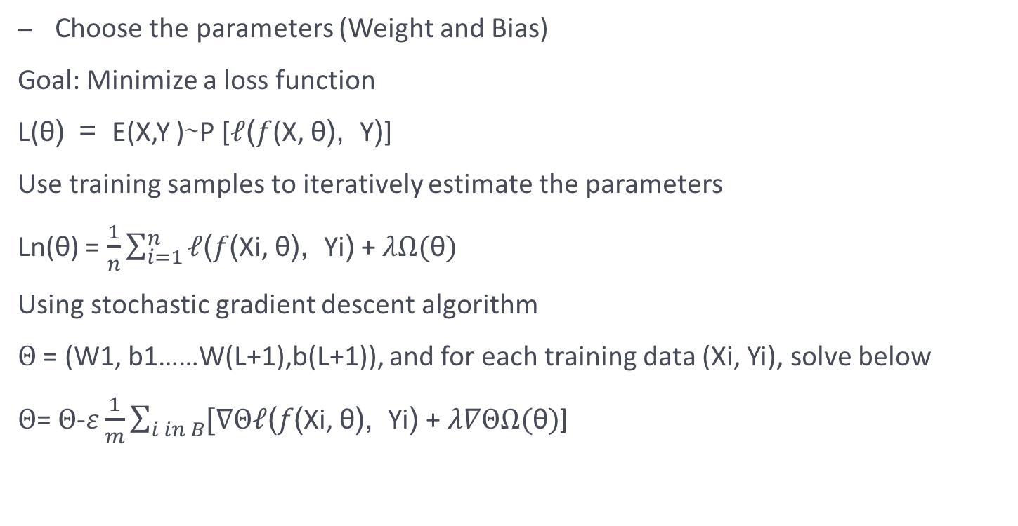
Deep Neural Network
Choose the parameters (Weight and Bias)
Goal: Minimize a loss function
L(θ) = E(X,Y )∼P [$ℓ$($f$(X, θ), Y)]
Use training samples to iteratively estimate the parameters
Ln(θ) = $\frac{1}{n}\sum_{i=1}^{n}{ℓ\text{(}f\text{(}\text{X}\text{i}\text{, }\text{θ}\text{), }\text{Y}\text{i}\text{)}}$ + $λΩ(\text{θ})$
Using stochastic gradient descent algorithm
$Θ$ = (W1, b1……W(L+1),b(L+1)), and for each training data (Xi, Yi), solve below
$Θ$= $Θ$-$ε\frac{1}{m}\sum_{i in B}{[∇Θℓ\text{(}f\text{(}\text{X}\text{i}\text{, }\text{θ}\text{), }\text{Y}\text{i}\text{)}}$ + $λ∇ΘΩ(\text{θ})$]
$ℓ$: Loss Function
Θ: Parameters to be estimated
$λΩ(\text{θ})$: L2 regularization

Slide 32
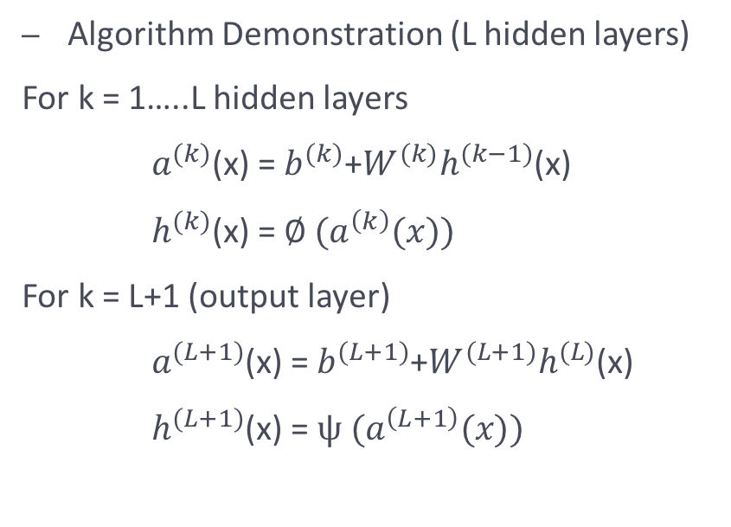
Deep Neural Network
Algorithm Demonstration (L hidden layers)
For k = 1…..L hidden layers
$a^{(k)}$(x) = $b^{(k)}$+$W^{(k)}h^{(k−1)}$(x)
$h^{(k)}$(x) = $∅ (a^{\left(k\right)}(x))$
For k = L+1 (output layer)
$a^{(L+1)}$(x) = $b^{(L+1)}$+$W^{(L+1)}h^{(L)}$(x)
$h^{(L+1)}$(x) = $ψ (a^{\left(L+1\right)}(x))$
Hidden Layer Activation Func
Matrix: row=#neuron in K,
col= #neuron in K-1
Output Layer Activation Func

Slide 33
Deep Neural Network
Tuning Parameters:
Activation: determines the function to activate neurons
Hidden_dropout: randomly drops out activated neurons thus eliminating over-fitting
Hidden: determines the number of hidden layers between input and output, and the dimension for each hidden layer

Slide 34
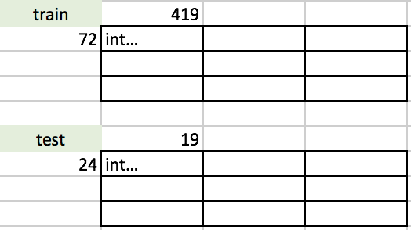
Deep Neural Network
Basic Set Up: 10 iterations, training (72*419), test (24*419)

Slide 35
Support Vector Machine
Application: Binary Classification (one again one for multi-categories)
Statistical Definition: Support Vector Machine works to determine the classifier function that best separate different categories by “drawing” a hyperplane that cut through the different classes, the hyperplane that maximizes the margin will be determined as the best classifier, and the number of data points that are in contact with the margin will be the support vector, thus the lower the number, the better the classifier. (Maneerat 2016)

Slide 36
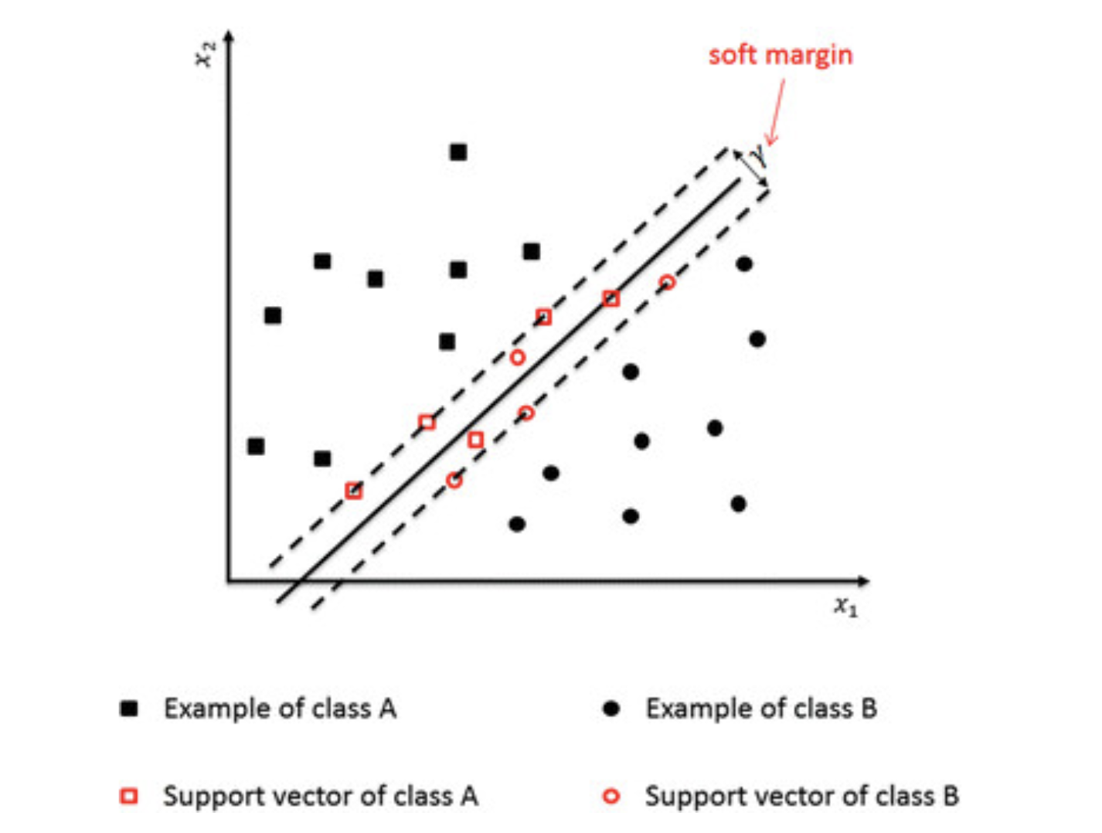
Support Vector Machine
Thus, the algorithm for support vector machine could be viewed as an optimization problem, maximizing the soft margin depicted on the left.
The farther a data point is from the margin, the more confident we are in classifying that

Slide 37
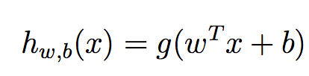
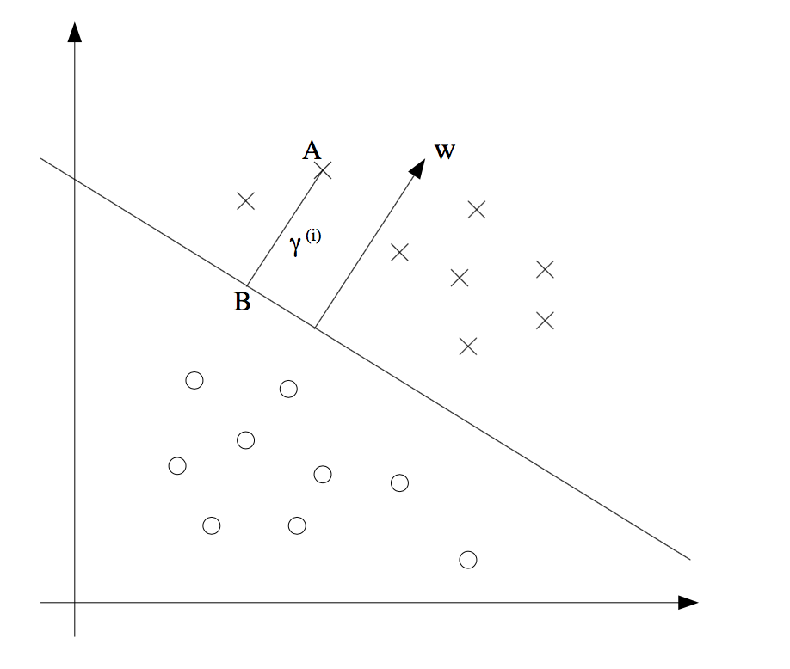
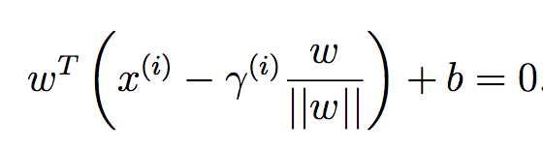
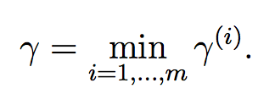
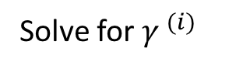
Support Vector Machine
Separating Hyperplane Equation
A: input x(i) of some training example
Solve for ${γ }^{(i)}$

Slide 38
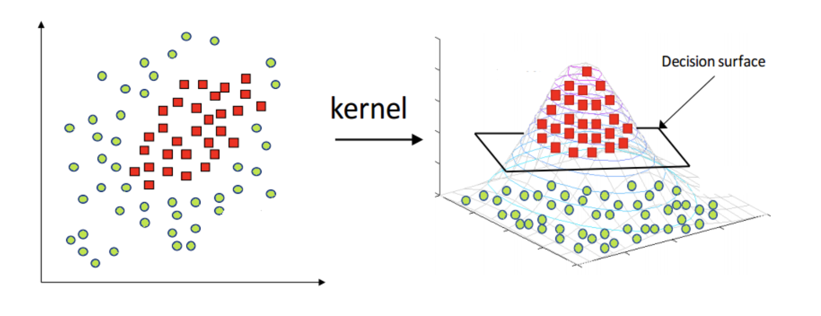
Support Vector Machine
Tuning Parameters:
Gamma: Parameter responsible for mapping kernel
C: Tradeoff between training error and testing error. Larger Cost will lead to smaller margin, vice versa. The higher is C, the higher is the weight given to in-sample misclassifi- cations
Kernel: where the kernel function transforms the data into the higher dimensional feature space so that a linear separation is possible. (Blog 2017)

Slide 39
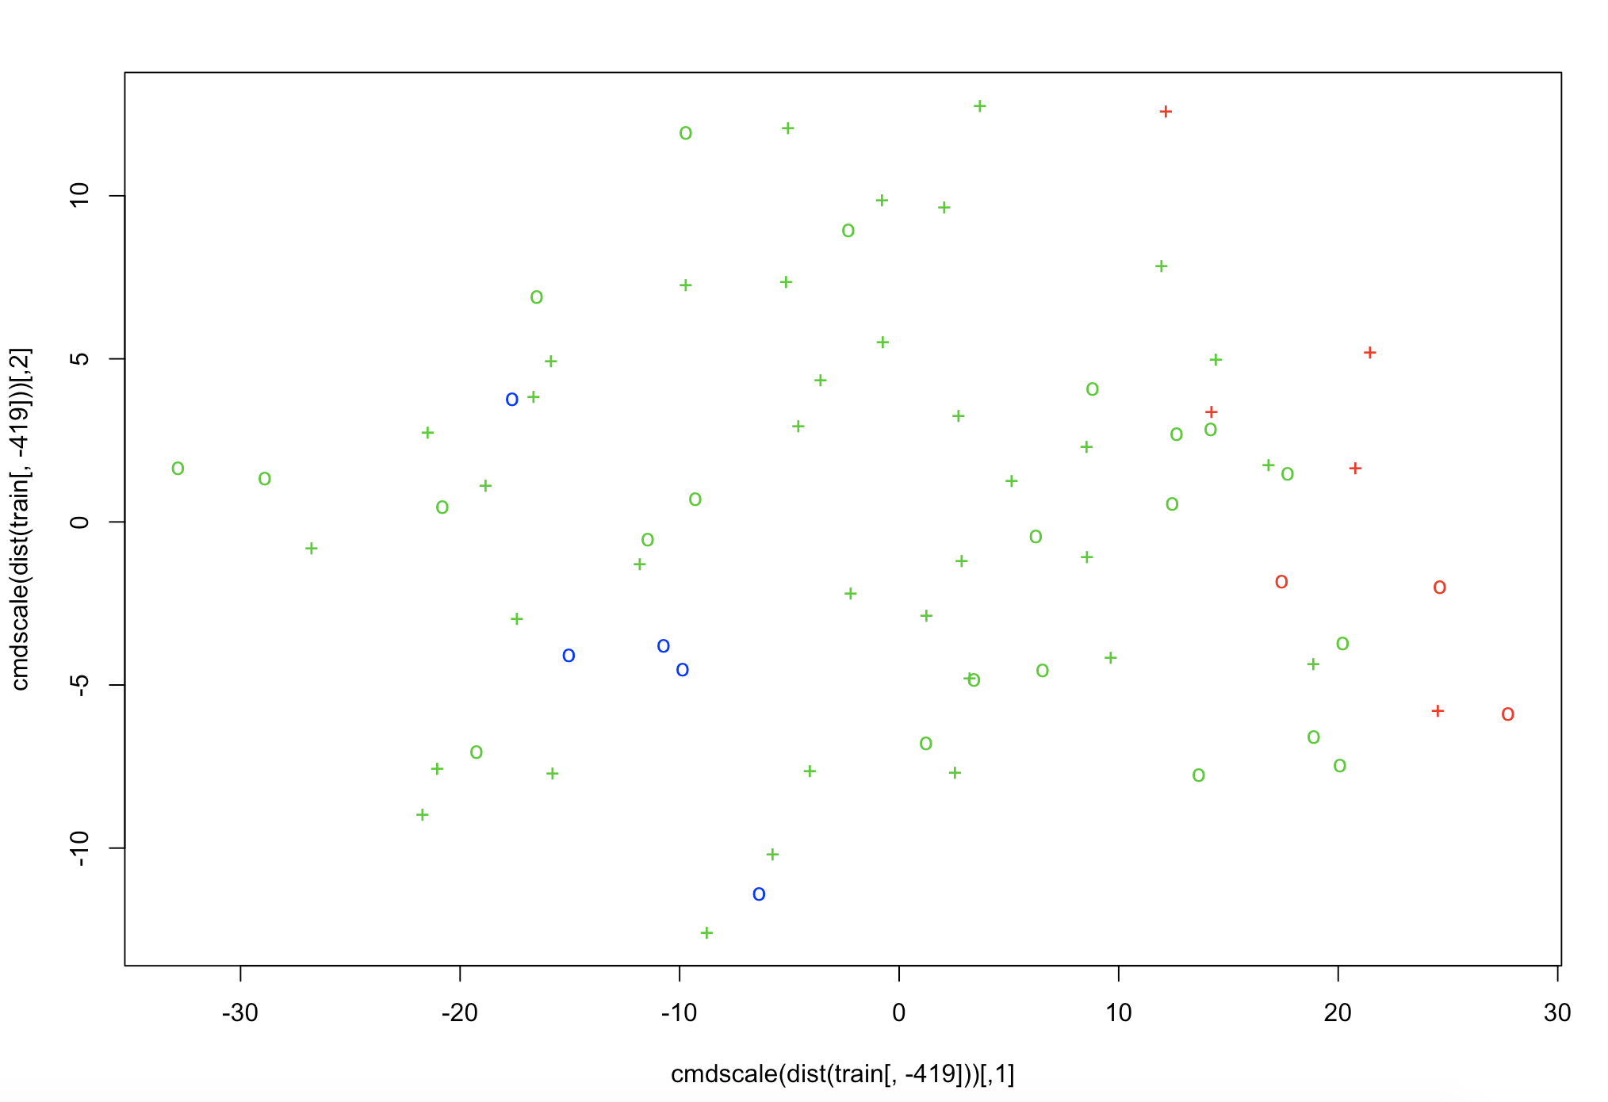
Support Vector Machine
Basic Set Up: 10 iterations, training (72*419), test (24*419)

Slide 40
Support Vector Machine
Advantages
Given kernel, it doesn’t have to be linear anymore
No assumptions about kernel transformation is needed
Controlling “C”, good out of training accuracy (Auria 2008)
Unique solution
Disadvantages
Complicated interpretation except visualization

Slide 41
Results Comparison No dimension reduction involved
 | Sensitivity | Specificity | FDR | Accuracy | F1_Score
Logistic+bagging | 0.8 | 0.95 | 0.1427 | 0.9125 | 0.4076
 | (0.0544) | (0.0154) | (0.0373) | (0.0169) | (0.0184)
Logistic+boosting | 0.7667 | 0.9389 | 0.1586 | 0.8958 | 0.3826
 | (0.0793) | (0.0193) | (0.0477) | (0.0208) | (0.0314)
Random forest | 0.5833 | 0.8667 | 0.3847 | 0.7958 | 0.2876
 | (0.0869) | (0.0301) | (0.0885) | (0.0343) | (0.0384)
XGBoost | 0.6333 | 0.8556 | 0.4383 | 0.8 | 0.2904
 | (0.0956) | (0.0312) | (0.0774) | (0.0290) | (0.0404)
DNN | 0.75 | 0.9722 | 0.0843 | 0.9167 | 0.4025
 | (0.0621) | (0.0093) | (0.0284) | (0.0139) | (0.0207)
SVM | 0.9444 | 0.500 | 0.2567 | 0.8333 | 0.315

Slide 42
Conclusion No dimension reduction involved
Techniques | Application | Advantages | Disadvantages | Package in R
Bagging | Regression Classification | Reduce Error Reduce Overfitting | Requires instability Interpretability | glmnet
Boosting | Regression Classification | Low Training Error Require no knowledge for previous learners | Susceptible to noises | glmnet
XGBoost | Regression Classification | Low Training Error One tree at a time, Speed | Longer Training time | xgboost
Random Forest | Regression Classification | Avoid overfitting | Longer Training time | randomForrest
Deep Learning | Regression Classification ☑️ | No data assumptions | Longer Training time | h2o
Support Vector Machine | Regression Classification ☑️ | Deal with Non-linear Test accuracy Visualization, Speed | Interpretability | Rpart, e1071

Slide 43
Will introduce dimension reduction techniques from here
Bspc ☑️
Smds ☑️
t-sne ☑️
LDA ☑️
KNN ☑️
Naïve Bayes ☑️
CART ☑️

Slide 44
Bair’s Supervised PC
Application: Originally proposed to tackle regression problem, but can be used on classification or survival as well
“Supervised”: Instead of utilizing all predictors to build PC, it uses a subset of predictors based on their association with the outcome (Bair 2004)
Advantage: Identify clusters of relevant predictors

Slide 45
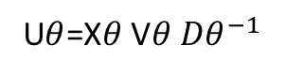
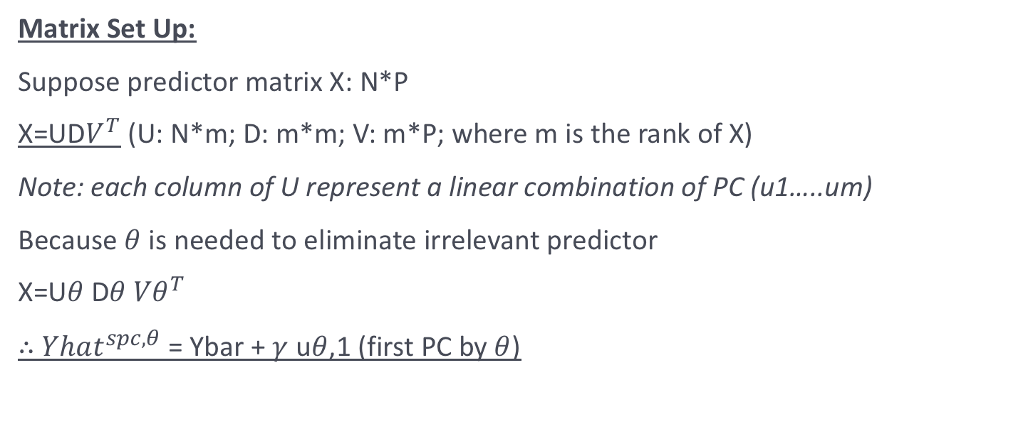
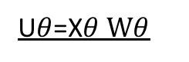
Bair’s Supervised PC
Matrix Set Up:
Suppose predictor matrix X: N*P
X=UD$V^{T}$ (U: N*m; D: m*m; V: m*P; where m is the rank of X)
Note: each column of U represent a linear combination of PC (u1…..um)
Because $θ$ is needed to eliminate irrelevant predictor
X=U$θ$D$θ {Vθ}^{T}$
$∴$ ${Yhat}^{spc,θ}$ = Ybar + $γ$ u$θ$,1 (first PC by $θ$)
U$θ$=X$θ$V$θ {Dθ}^{−1}$
U$θ$=X$θ Wθ$

Slide 46
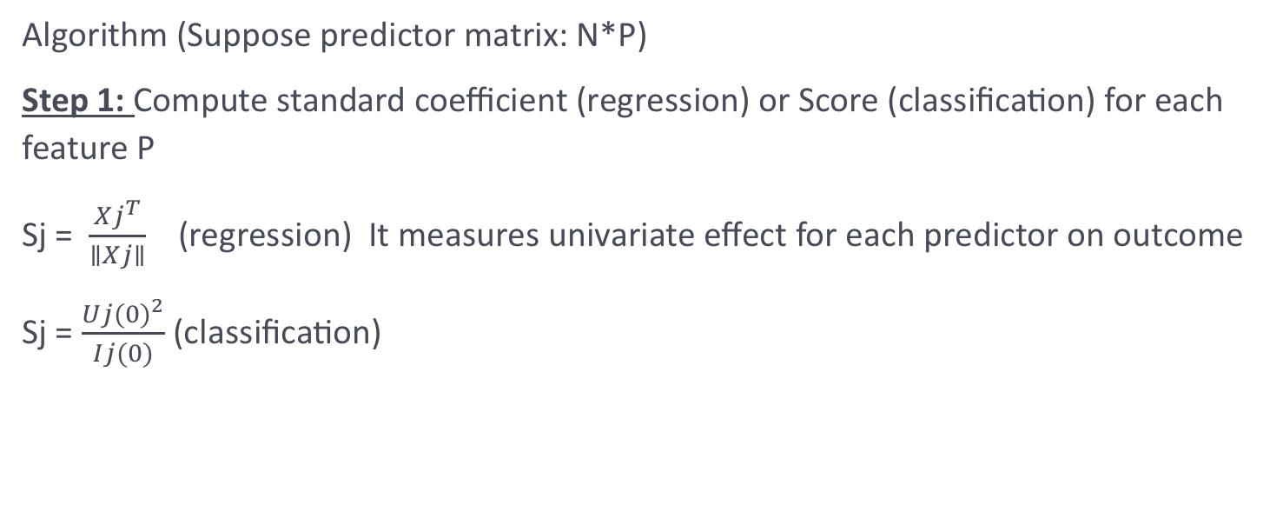
Bair’s Supervised PC
Algorithm (Suppose predictor matrix: N*P)
Step 1: Compute standard coefficient (regression) or Score (classification) for each feature P
Sj = $\frac{{Xj}^{T}}{∥Xj∥}$ (regression) It measures univariate effect for each predictor on outcome
Sj = $\frac{Uj{(0)}^{2}}{Ij(0)}$ (classification)
First derivative of log-likelihood between Xj and Y w/respect to $β$
Second derivative of log-likelihood between Xj and Y w/respect to $β$

Slide 47
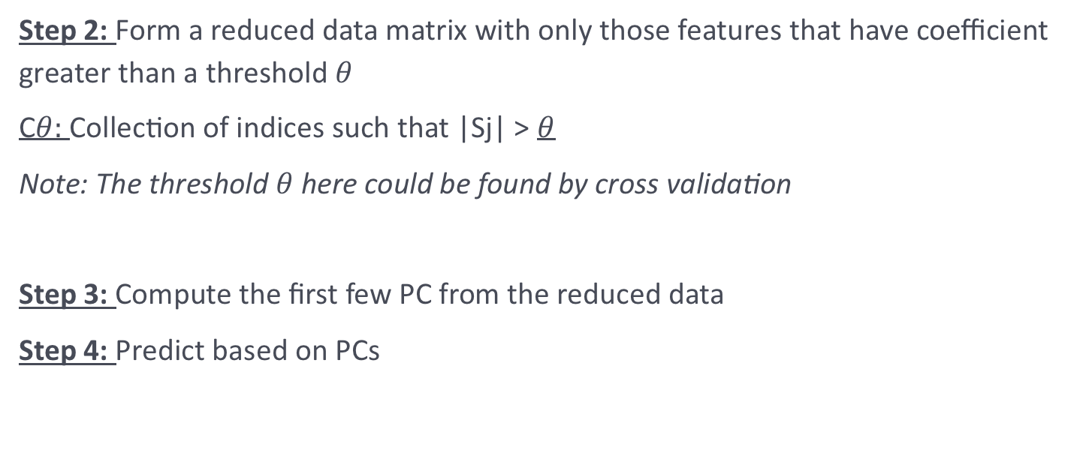
Bair’s Supervised PC
Step 2: Form a reduced data matrix with only those features that have coefficient greater than a threshold $θ$
C$θ:$ Collection of indices such that |Sj| > $θ$
Note: The threshold $θ$ here could be found by cross validation
Step 3: Compute the first few PC from the reduced data
Step 4: Predict based on PCs

Slide 48
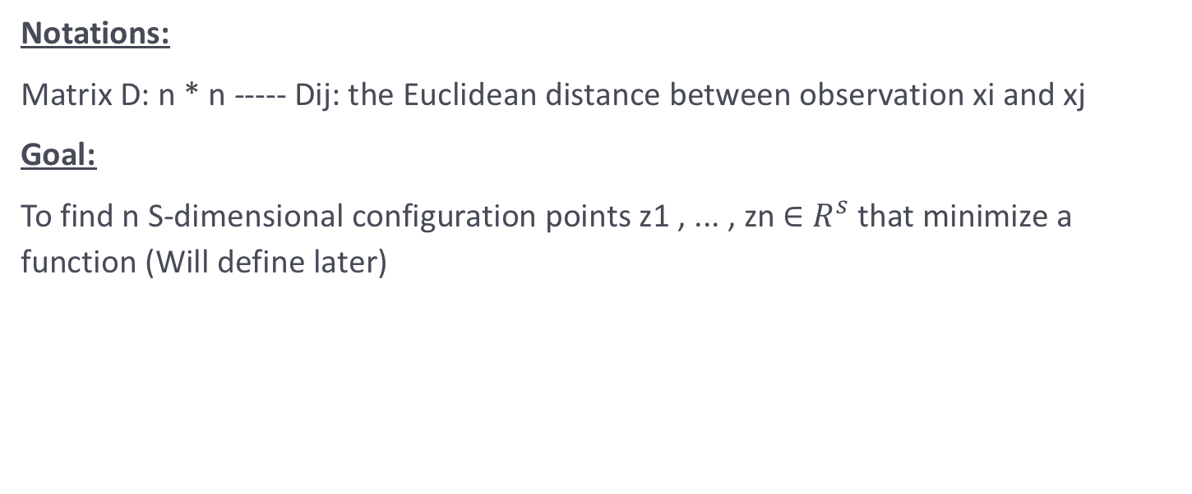
Supervised Multidimensional Scaling
Notations:
Matrix D: n * n ----- Dij: the Euclidean distance between observation xi and xj
Goal:
To find n S-dimensional configuration points z1 , ... , zn ∈ $R^{s}$ that minimize a function (Will define later)

Slide 49
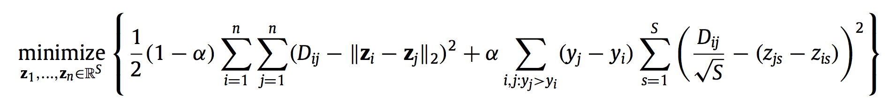
Supervised Multidimensional Scaling
“Supervised”: If yi ≈ yj, then we construct configuration points zi and zj that are not too far apart; otherwise, we construct configuration points such that ∥zi − zj∥ is large. (Tibshirani 2010)
Optimization Function
Put two terms on the same scale
Take outcome into consideration
Alpha is the tuning, return to unsupervised when zero
When yj>yi, and is highly supervised, then Zj>Zi, which still preserve similarity

Slide 50


Supervised Multidimensional Scaling
Supervised VS Unsupervised (In term of separation and classification)
Tibshirani 2010

Slide 51
Supervised Multidimensional Scaling
Advantages:
Visualization

Slide 52
Linear Discriminants Analysis
Development Overview:
Fisher discriminant analysis (Scholkopft and Mullert, 1999)
Problem: Can’t capture multi-modality, and within-cluster similarity
Local-preserving projection (Niyogi, 2004)
Local Fisher discriminant analysis (Sugiyama, 2006)

Slide 53


Linear Discriminants Analysis v
Goal: Reduce Dimensions while preserving class discriminatory information
Basic rational: To project data points on a line that maximize separation between classes, and obtain a scalar Y=$W^{T}$X

Slide 54



Linear Discriminants Analysis
Define Objective Function involving the scalar Y
Because we project those points onto a line, so our objective function would be the distance between projected means
???Problem with the above: didn’t take standard deviation within one classification into consideration
Mean vector of each classification in x space
Mean vector of each classification in y space

Slide 55


Linear Discriminants Analysis
Fisher’s Solution: Normalize within groups
Notation:
Scatter (Variance):
Fisher’s Objective Function
Statistical significance: In this way, Fisher makes sure that data points belonging to the same class are projected near to each other, and data points in different classes are being separated after projection.

Slide 56






Linear Discriminants Analysis
Now, What about the “w”?
Notation:
Within-class scatter:
Differences between projected means
scalar Y=$W^{T}$X
Between-class scatter
Final
Objective Function
All we have to do is to find the derivative and find the maximum value of J(w)

Slide 57

Linear Discriminants Analysis
Advantages:
Separation
Visualization
Disadvantages:
At most K − 1 feature projections (K: # of classes)
It assumes unimodal Gaussian likelihoods
It will also fail if discriminatory information is not in the mean
Computing time

Slide 58



Linear Discriminants Analysis
LDA in R Output

Slide 59
K nearest neighbor
Highlight: Build classification without assuming any form of the function
Ideas: Find K observations (u1,u2,...up) in the training data set that are similar to a new observation that we wish to classify and to use these observations to classify the new observation
What do we mean by “near”?
Euclidean Distance between (x1, x2, ...xp) and (u1,u2,...up) is
(x1-u1)^2 +(x2-u2)^2 +···+(xp-up)^2

Slide 60

K nearest neighbor
When K=1; 1-NN: we find the observation that is closest (the nearest neighbor) and set vb = y where y is the class of the nearest neighbor.
Extend this idea: K-NN (By majority voting from neighbor observations)
When K=n, then we are just predicting the new observation by assigning it the majority classification.

Slide 61
t-SNE
Application: Regression and Classification
Statistical Definition: t-SNE stands for t-distributed stochastic neighbor embedding. Its main function is to transform a high dimensional data into low dimensional data while keeping the structure of the data unaffected (in order words, similarity is preserved)
Similarity: measures the distances between all points and the point of interest.

Slide 62


t-SNE
Un-scaled similarities: the longer the length , the higher the similarity
T distribution

Slide 63


t-SNE
The concept of Similarity
The Euclidean distance
The density surrounding the point of interest
Normalize the similarity term to let them sum up to one, because sparser region might have a wider t-distribution curve
Because the similarity depends on density surround that point, we expect pij and pji to be different, thus we take the average to get the final similarity measure

Slide 64


t-SNE
Tuning Parameters:
Perplexity [5,50]: optimal number of neighboring, balance between local and global variation
Min_cost: minimum cost value to stop iteration
eta: Learning rate

Slide 65

Naive Bayes
Why “Naive”?
Makes the assumption that the presence of a particular feature in a class is unrelated to the presence of any other feature
Algorithm:
Calculates the posterior probability for each class. The class with the highest posterior probability is the outcome of prediction.

Slide 66
Naive Bayes
Advantages:
Fast and Easy calculation
Performs well for classification
Disadvantages:
Need predictors to be independent

Slide 67
Results Comparison Dimension reduction involved
 | Sensitivity | Specificity | FDR | Accuracy | F1_Score
SMDS
 | 0.4167 | 0.7667 | 0.648 | 0.6792 | 0.188
LDA
 | 0.8167 | 0.8444 | 0.3551 | 0.8375 | 0.3576
KNN
 | 0.8833 | 0.9833 | 0.0486 | 0.9533 | 0.455
CART
Naïve Bayes

Slide 68
Conclusion Dimension reduction involved
Techniques | Application | Advantages | Disadvantages | Package in R
BSPC | Regression Survival
SPCA | Regression Survival
SMDS
LDA | Classification | Computing Speed | Multi-collinearity | MASS
t-SNE |  |  | Not Supervised | Rtsne
KNN | Classification | Computing Speed |  | class

